Slide 1

Last Project POC
Building a survival game

Slide 2
Welcome to island,
You have washed off from your boat to an unrecognize island.
Find food, gather resources and survive until the rescue team will show up.
It has to, right?..

Slide 3
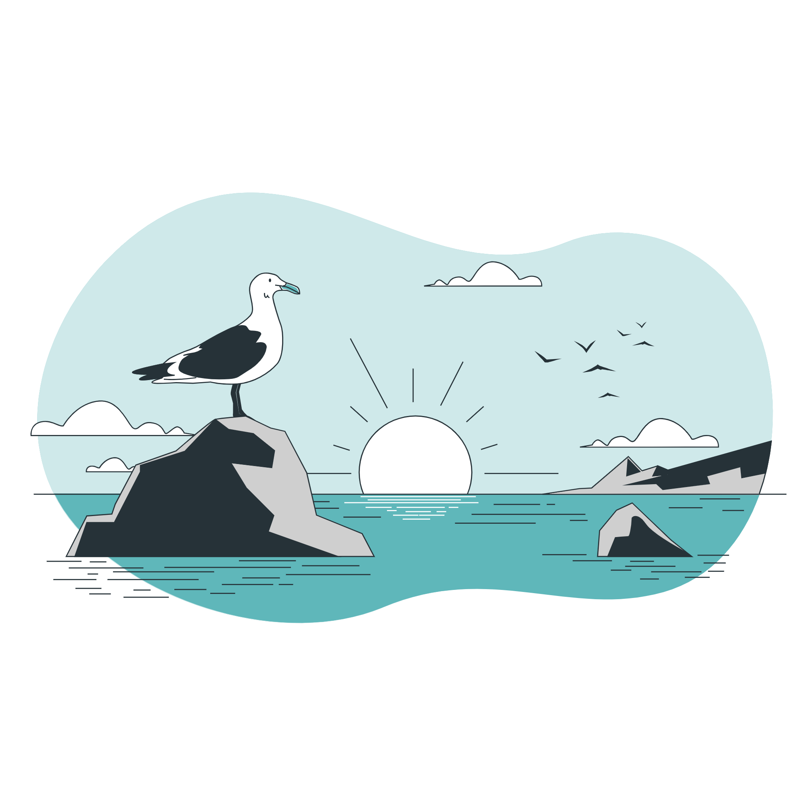
The Game
The game is a survival game where a player needs to gather resources, craft, build and get familiar with the surrounding in order to survive for the longest.
The target audience for the game is players who already like and enjoy survival games like Don’t Starve and Len’s Island.

Slide 4
How does it work
In the game there are a few core mechanics –
Moving in the world (should feel rewarding)
Interaction with objects around (picking up things)
Crafting (in order for the game loop to work)
Building (to create your customizable base)
The game fun should come from having all the systems work together as the player guesses they will & having an excited environment to explore.

Slide 5
Art Style
The game is set in a low–poly style.
The environment should feel alive around the player.

Slide 6

Idea & Reference
Or – why is this my final project
The idea is to experience building a game with complicated systems to enhance my programming abilities.
In my opinion, a lot of the game focus should be in environment and feel – to make the player engaged with continue playing and have a goal to play the game.
Which lets me a great opportunity to focus on modeling the player character and managing art and animation around it.
Also, I love survival games and building one myself is a great fun.

Slide 7
Playable Session

Slide 8

Plans going forward
As of now, most of the basic mechanics are already working at basis level (with foundation to build upon).
Now the main focus would be polish of the environment and art before going back and advancing the systems to a greater point.

Slide 9
What will be in the finished game?
The finished game should be everything you saw with a lot of polish sessions.
It should be playable with minimum bugs or distractions.

Slide 10
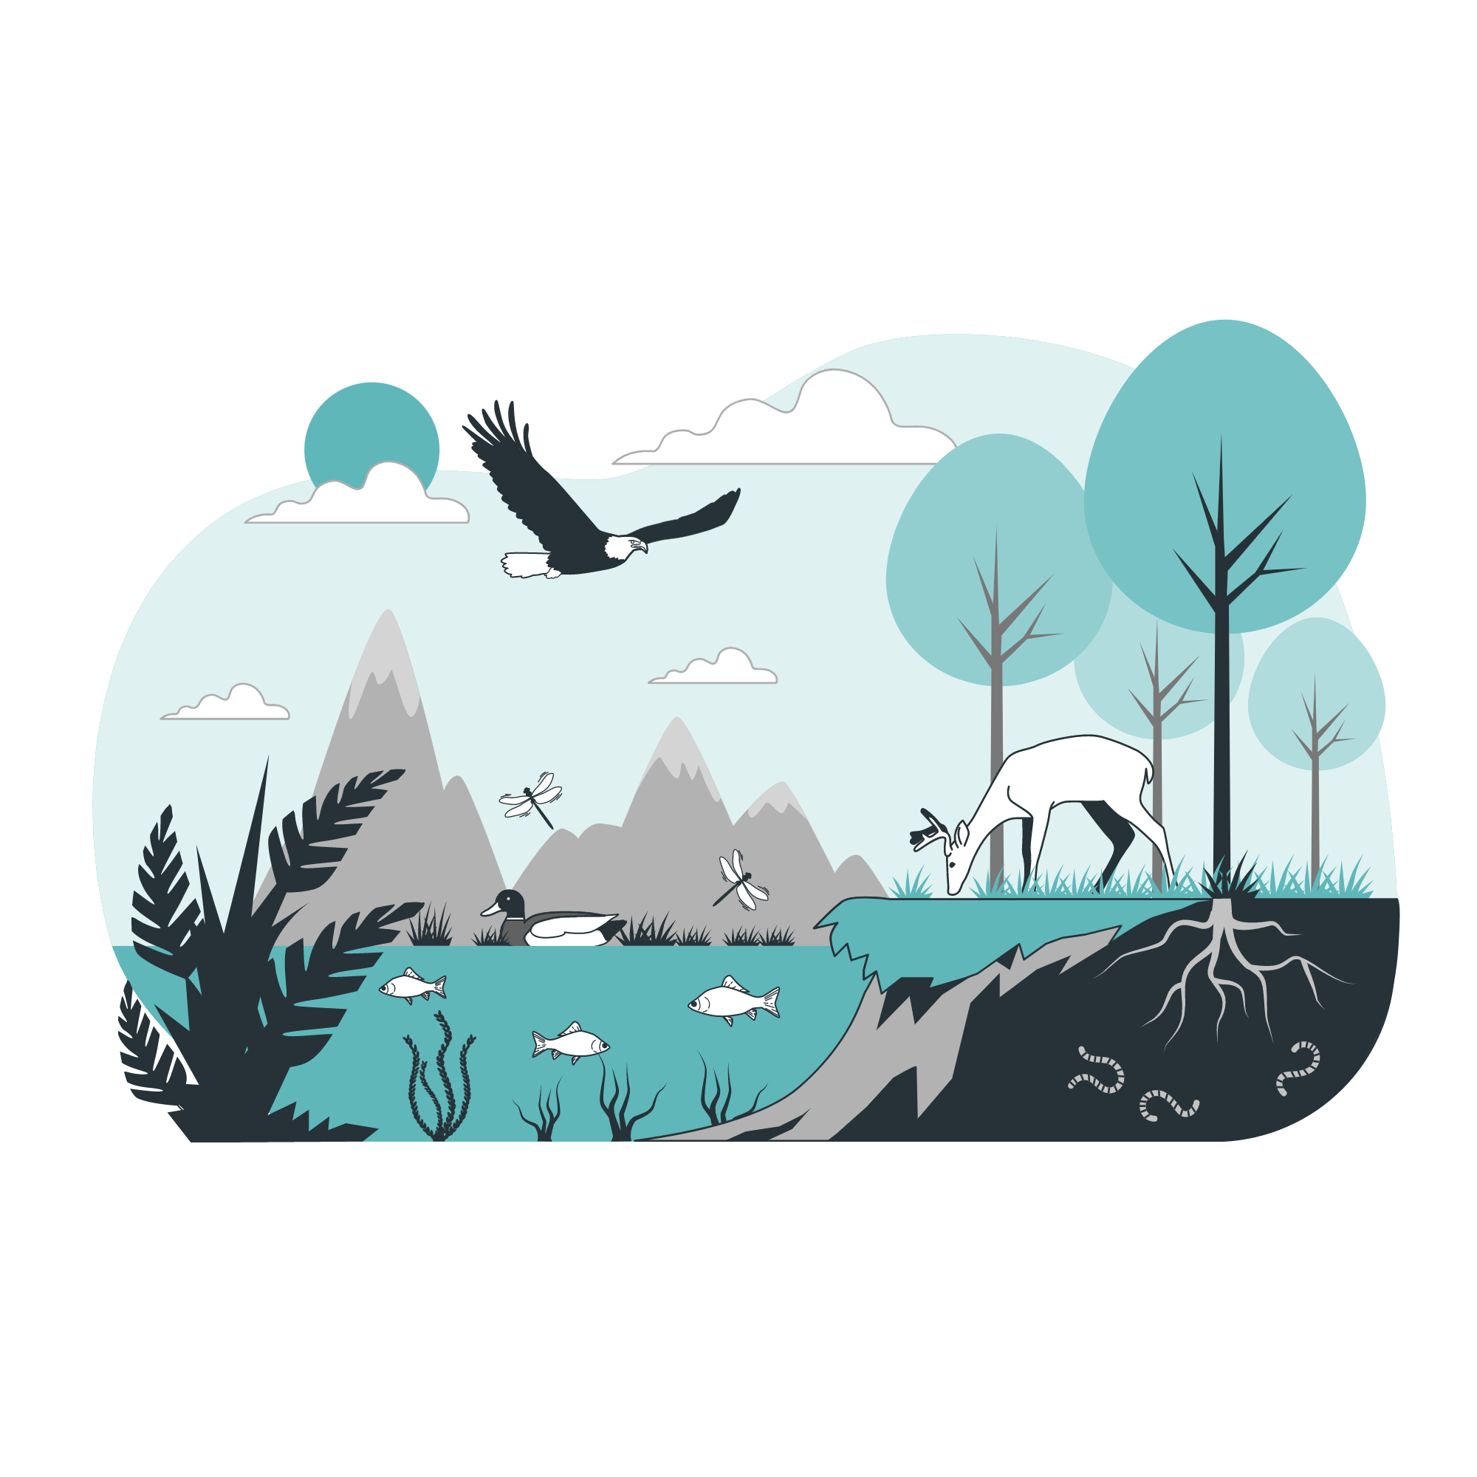
Thank you for listening

